Slide 1
Intro to Web
LASP Summer Training
Notes:
\

Slide 2
HTML
Hyper Text Markup Language
Describe the underlying structure of a webpage using markup
HTML tags label content for later use by CSS or scripts
HTML pages can be saved in a .HTML file or dynamically generated inside of a different file (i.e. generated inside a .py script)

Slide 3
<!DOCTYPE html> <html> <head> <title>Page Title</title> </head>
<body> <h1>Section Heading</h1>
<p>
Hello world.
</p> </body>
</html>
Must be the first thing in an HTML document-- this is an instruction to the web browser about what version of HTML the page is written in
Tells the browser that everything in these tags will be HTML. Container for all other HTML elements-- useful for formatting the entire page with CSS.
Container for all metadata and script links. Can contain <title> <style> <base> <link> <meta> <script> <noscript>
Provides a title for the page for the browser’s toolbar, bookmarks, and search engine results.
Contains all HTML that the user will see on the page, such as paragraphs, images, and headers.
Example of a section heading. H1 through H6 exist for formatting and parsing purposes.
Example of a paragraph tag.

Slide 4
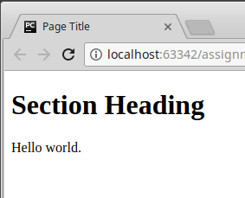
<!DOCTYPE html> <html> <head> <title>Page Title</title> </head>
<body> <h1>Section Heading</h1>
<p>
Hello world.
</p> </body>
</html>
Describe left stuff here

Slide 5
Other Elements
<nav>
<a href =”path/to/destination/”> Link </a>
</nav>
<form action=”script.php”>
<input type=”text” name=”input1”>
<input type=”submit” value=”submit”>
</form>
<script>
<span>
<textarea>
<ul>
<ol>
<li>

Slide 6
CSS
Cascading Style Sheets
Describes how the HTML should be styled and displayed
Can be applied to many web pages at once
Saved in an external .CSS file or typed inline into an HTML file’s <head> inside a <style> element.

Slide 7
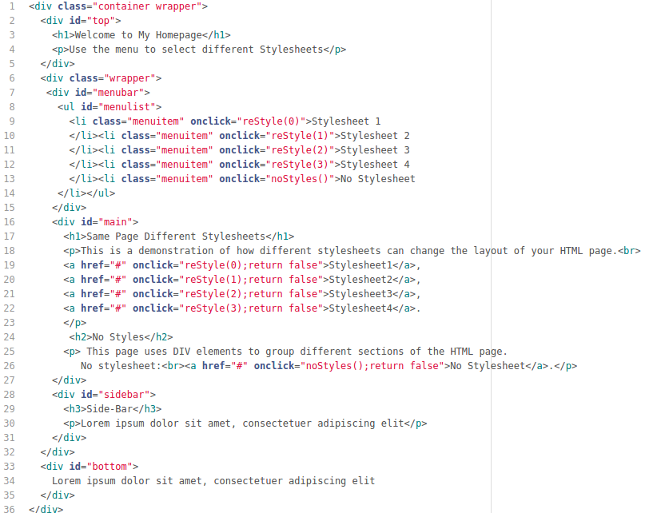

Slide 8
Notes:
Entire “page” including footer-- style sheets using this to change font, background, and overall style of page.

Slide 9
Notes:
Div within the div- this is the entire page minus the footer/bottom. Anything within this div will affect the menu bar, main section of the page, and sidebar.

Slide 10
Notes:
Just the menu bar-- this includes the unordered list and all list items. This functions as a small navigation bar for the page, swapping out the style sheet whenever you click on one of the list item elements.

Slide 11
Notes:
This functions as a small navigation bar for the page, swapping out the style sheet whenever you click on one of the list item elements.

Slide 12
Notes:
Even though there is only one unordered list on this page (the <ul> tag), it is still best practice to give every tag that will be selected an ID in order to future-proof your page. This is also why the unordered list is nested inside another div-- the div itself can be selected separately from the list it contains, and more elements can be added within the menu bar that won’t affect the list of clickable items.

Slide 13
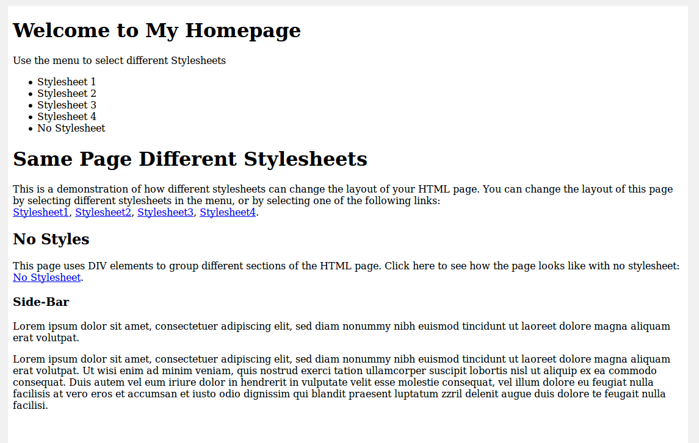
CSS Examples via w3schools.com
Figure 3. No Stylesheet
Notes:
Sample HTML without a stylesheet, just plain text.

Slide 14
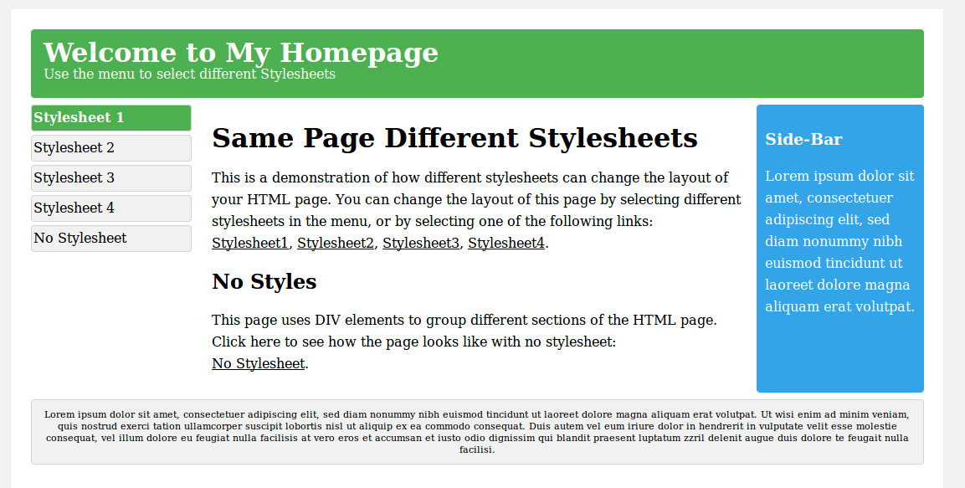
CSS Examples via w3schools.com
Figure 4. Stylesheet 1

Slide 15
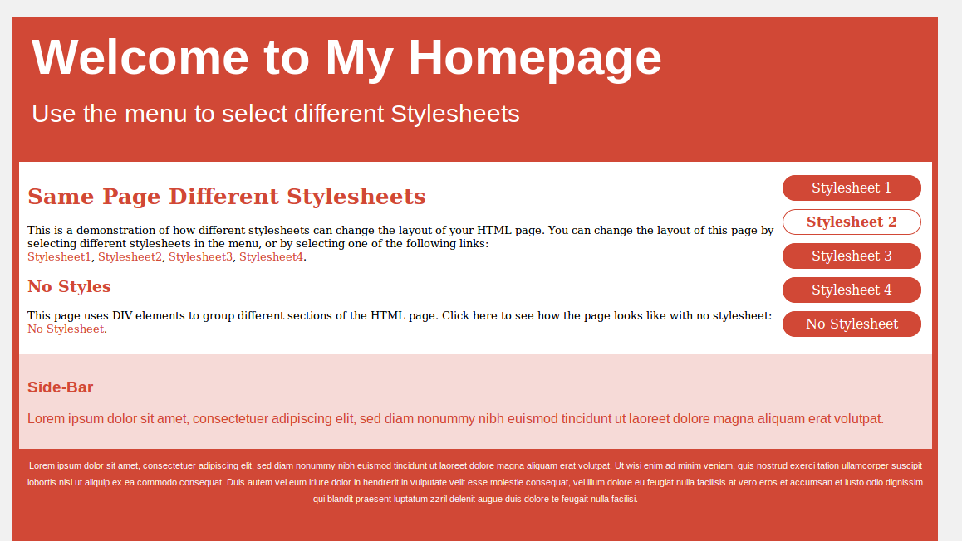
CSS Examples via w3schools.com
Figure 5. Stylesheet 2

Slide 16
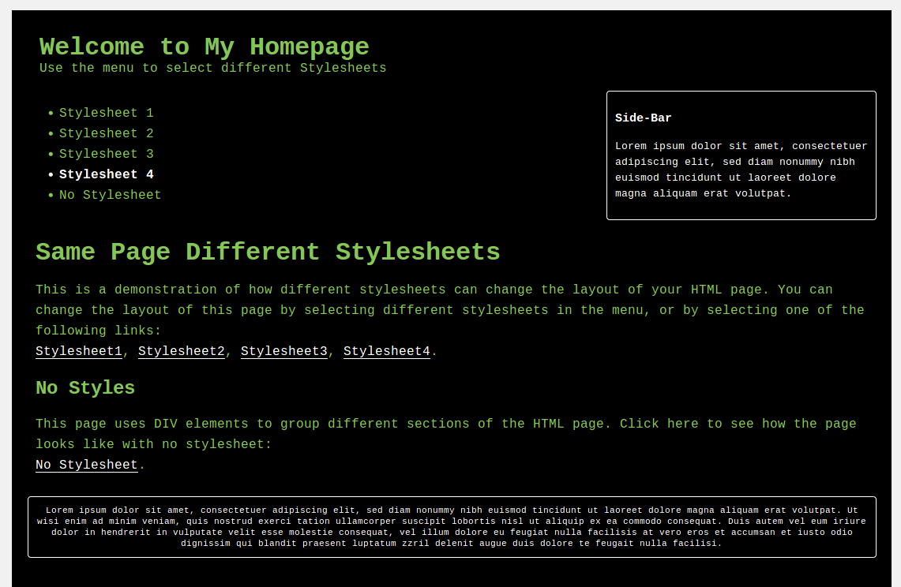
CSS Examples via w3schools.com
Figure 6. Stylesheet 4

Slide 17
CSS Syntax
Selector Declaration Declaration
p { color: red; text-align: center; }
Property Value
Property Value
Notes:
CSS syntax consists of a selector and a declaration block. The selector points to the html element that you want to style. The declaration block contains one or more declarations separated by a semicolon. Each declaration includes a CSS property and value pair separated by colons. The declaration block ends with a semicolon and is surrounded by curly brackets. So in this case, all paragraph elements on the page will have red text and be centered on the page.

Slide 18
Selectors
Element Selector
ID Selector
Class Selector
p { color: red; }
#mainP { color: red; }
.center { color: red; }
p.center { color: red; }
Notes:
.center selects everything with the class .center regardless of element, while p.center selects all paragraph elements with the class of .center.

Slide 19
Grouping Selectors
p {
margin: 0px;
padding: 5px;
font-family: Verdana, Arial, Helvetica, sans-serif;
}
ul li {
margin: 0px;
padding: 5px;
font-family: Verdana, Arial, Helvetica, sans-serif;
}
p, ul li {
margin: 0px;
padding: 5px;
font-family: Verdana, Arial, Helvetica, sans-serif;
/* by the way, this is how you comment */
}
VS.
VS.
Notes:
Grouping selectors to cut down on the amount of code you need to write or copy-paste or whatever. This slide also demonstrates how specific you can get with selectors, i.e selecting ul li. This selects the list element WITHIN unordered list element. This means that any list elements that aren’t nested within an unordered list (such as the ones within an ordered list), won't be affected. Just another layer of specificity you can get when making things look user-friendly.

Slide 20
Inserting CSS
External Style Sheet
Internal Style Sheet
<head>
<link rel="stylesheet" type="text/css" href="../css/style.css" >
<link rel= "stylesheet" href= "{{url_for('static',filename=’../css/style.css') }}" >
</head>
<head>
<style>
#main-body {
background-color: #455CA8;
}
</style>
</head>
Notes:
External style sheet, internal style sheet, and inline. Inline is really bad practice, as you want to keep code as modular and reusable as possible. 2nd external stylesheet link is an example of linking within Flask, the first one is just for a standard html page.

Slide 21
Cascading- Resources and Additional Reading
A Selector’s Priority Depends On:
Importance
“!important” after a value supersedes everything
Specificity
Element selectors < Class selectors < ID Selectors
Source order
if multiple competing selectors have the same importance and specificity, later rules will win over earlier rules
Click for More Information on CSS Cascade and Inheritance
Notes:
Complicated, here’s a resource to read more about it. Goes into how CSS cascades and what takes precedence over other things, such as ID having priority over class.
Specificity is basically a measure of how specific a selector is — how many elements it could match. As shown in the example seen above, element selectors have low specificity. Class selectors have a higher specificity, so will win against element selectors. ID selectors have an even higher specificity, so will win against class selectors. The only way to win against an ID selector is to use !important.
The amount of specificity a selector has is measured using four different values (or components), which can be thought of as thousands, hundreds, tens and ones — four single digits in four columns: Specificity can all be put in a chart that you can see at the link, but really unless you’re doing some hardcore CSS you don’t need to know that as much. Could be cool to know.
Source order: if a selector’s importance and specificity is the same (ie both just select p and set the text color to blue and red), the one that is further down on the page will win. So if you have p{color: blue} and then p{color:red}, red will win because red is later.

Slide 22


Site Generation with Flask

Slide 23

Bare-bones web framework that leaves creative decisions up to the developer
Simple, flexible, and adaptable
Alternatives: Django, Cherrypy
Notes:
Flask implements the bare-minimum and leaves the rest up to the developer or plugins, which makes it easier to play around with than Django, which is one of the more popular web frameworks. Flask balances a quick setup with extensive web support and documentation. It is widely-used, and so many common issues are well-documented and easier to solve. Cherrypy is another option, but I’ve personally found it to be much less widely used, less well-documented, and less supported in general.
Simple, flexible, and unopinionated-- Flask lets you choose how to set up things, as opposed to Django which provides an all-inclusive experience: you get an admin panel, database interfaces, an ORM, and directory structure for your apps and projects out of the box. I personally feel this makes Flask better for learning. You can make things your own way rather than using mostly pre-fabricated components that somebody else has figured out. For actual development purposes, yeah that makes Django great. It saves you a lot of work. But Flask’s setup is great for learning and its ease of setup makes it more ideal for your smaller-scale dummy project.

Slide 24
Flask Local Server Setup & Simple “Hello World”
Create “runflask.py”
from flask import Flask
app = Flask(__name__)
@app.route("/")
@app.route("/index")
def hello():
return "Hello, World!"
if __name__ == "__main__":
app.run(debug=True)
>>> Running on http://127.0.0.1:5000/ (Press CTRL+C to quit)
Notes:
Line 1 imports Flask
Line 3 initializes an app variable, using the __name__ attribute
Line 5 is where the magic of Flask happens. The @app.route is a Python decorator. It takes the function directly below it and modifies it. In this case, we use this to route traffic from a specific URL to the function directly below. Using different @app.route calls, we can 'trigger' different parts of the code when the user visits different parts of our application. In this case, we only have a single route /, which is the default "root" of our application.
In Line 6 the function name hello is not important. In stead of calling this function from somewhere else in our code, it will be called automatically. It's still a good practice to give it a relevant name though.
Line 7 returns the string to our user. Usually we would render a template or return HTML here so that users will see a nicely formatted page, but returning a Python string works fine too.
Line 9 is normal Python boilerplate to make sure we don't run anything automatically if our code is imported by another Python script.
Line 10 calls the run() method of the app we initialized in Line 3. This starts the development server for Flask and allows us to visit our web application from our local machine by visiting localhost
http://127.0.0.1:5000/-- 120.0.0.1 means you’re running this on your computer’s local host and the site cannot be accessed from outside your personal machine. :5000 is the port it’s running on, and this may need to be reassigned but :5000 generally should work for you. If you visit that http://127.0.0.1:5000 address, you should see your site.

Slide 25
Templates
from flask import Flask, render_template, redirect, request, url_for
app = Flask(__name__)
@app.route("/")
@app.route("/index")
def hello_world():
return ‘ ’ ’
<html>
<head>
<link rel= "stylesheet"
type= "text/css" href=
"{{url_for('static',filename=’../css/style.css') }}" >
<title> Home Page </title>
</head>
<body>
<h1>Hello World</h1>
</body>
<html> ‘ ’ ’
if __name__ == "__main__":
app.run(debug=True)
Notes:
Here’s the ineffecient and less modular way of doing things. If you have a one-page webpage and know it will never grow beyond this, it could work. But flask has a handy thing called templates that can save you a lot of time and make your code looks cleaner and more modular. As an example, maybe you have a header, navbar, menu, etc. that you want to keep consistent across your webpages but you want the body content to change with each page. Or you want the header to change depending on whether a user is logged in or not. You can use templates and extend a base HTML page that will automatically reuse all of that code without cluttering up your code.

Slide 26
run.py
base.html
from flask import Flask, render_template
app = Flask(__name__)
@app.route("/")
@app.route("/index")
def hello_world():
return render_template("base.html")
if __name__ == "__main__":
app.run(debug=True)
<!DOCTYPE html>
<html>
<head>
<link rel= "stylesheet" type= “text/css”
href= "{{url_for('static',filename=’../css
style.css') }}" >
<title> Home Page </title>
</head>
<body>
<ul>
<li><a href="/index">Index</a></li>
<li><a href="/home">Page 2</a></li>
<li><a href="/page">Page 3</a></li>
</ul>
<hr>
{% block body %}
<h1>Hello World</h1>
<p> This is the body </p>
{% endblock%}
</body>
<html>
Notes:
Logic in flask HTML pages uses curly bracket syntax. Outside of HTML pages, it’s still plain ol’ python. Import render_template/
Also added a small navigation bar in the form of an unordered list. A <link> is included to a small style sheet that, as you can see, is affiliated with base.html.

Slide 27
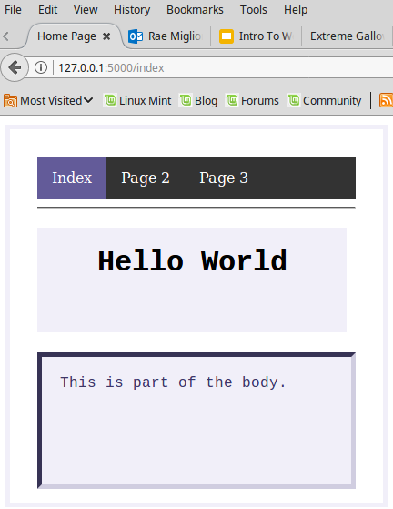
Figure 7. “Hello World” Using Flask Template

Slide 28
Extending Templates
run.py
home.html
from flask import Flask, render_template
app = Flask(__name__)
@app.route("/")
@app.route("/index")
def hello_world():
return render_template("base.html")
@app.route("/home")
def home():
return render_template("home.html")
if __name__ == "__main__":
app.run(debug=True)
{% extends "base.html" %}
{% block body %}
<h1> Wow it’s a new page </h1>
<p>This extends base.html</p>
{% endblock %}
Notes:
If you have other pages that keep the same basic structure as your first page, extending templates is an easy solution. Instead of repeating the structure of the nav bar and head, you can just utilize the {% block body %} logic we inserted in base.html. Now, everything but what was inside of the block elements is retained. It saves a lot of time and space.

Slide 29
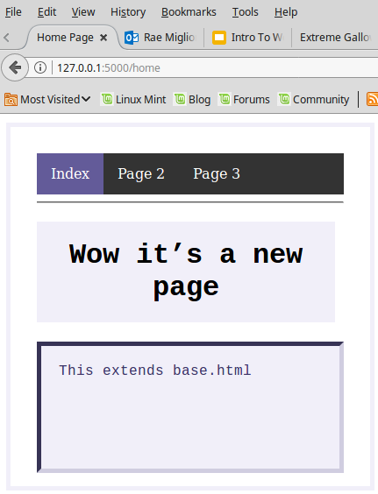
Figure 8. Extending a template to make a second page

Slide 30
Variables in Webpage
run.py
home.html
from flask import Flask, render_template
app = Flask(__name__)
@app.route("/")
@app.route("/index")
def home():
user = {‘username’: ‘Alice’}
return render_template("home.html", user=user)
if __name__ == "__main__":
app.run(debug=True)
{% extends "base.html" %}
{% block body %}
<h1>
Wow it’s a new page
</h1>
<p>
Hello, {{ user.username }}
</p>
{% endblock %}

Slide 31
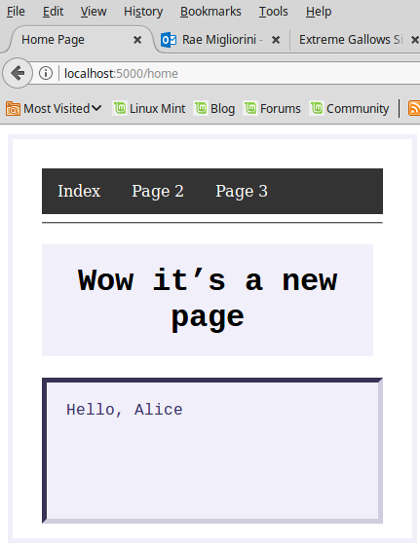
Figure 9. Using variables inside HTML pages

Slide 32
Conditional Statements in Webpage
run.py
Head of base.html
from flask import Flask, render_template
app = Flask(__name__)
@app.route("/")
@app.route("/index")
def hello_world():
return render_template("base.html", title= ’Welcome’)
@app.route("/home")
def home():
user = {‘username’: ‘Alice’}
return render_template("home.html", user=user)
if __name__ == "__main__":
app.run(debug=True)
<!DOCTYPE html>
<head>
{% if title %}
<title> {{ title }}- Your Site</title>
{% else %}
<title>Welcome to Site</title>
{% endif %}
</head>

Slide 33
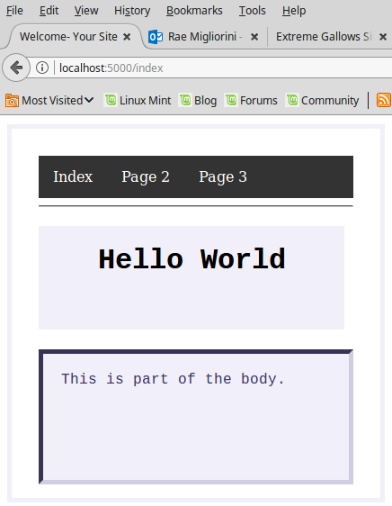
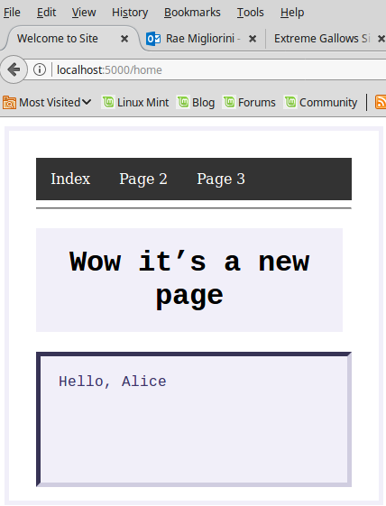
Figures 10 & 11. Using conditional statements and variables in a web page.
Notes:
Because base.html is extended in home.html, the if-then statement also applies to home.html. Look at title to see this in practice.

Slide 34
SQLite3 as an alternative to MySQL
Install sqlite3
Create database in command line
Create schema, either in another file or directly after creating the db in the command line
$ sqlite3 exampledb.db
sqlite>

Slide 35
Database connection (SQLite3)
import sqlite3
def connection():
con = sqlite3.connect('exampledb.sqlite')
c = con.cursor()
return c, con
Notes:
Flask does not support databases natively, which is good because it gives you more freedom in what sort of database you wish to use to connect. For this example, we’ll be using SQLite3. Connection with mysql will be similar.

Slide 36
views.py
from flask import Flask, render_template, request
from dbconnect import connection
…
@app.route('/dashboard/', methods=['GET'])
def dashboard():
c, con = connection()
c.execute("SELECT username, score
FROM users
ORDER BY score DESC LIMIT 10;")
data = c.fetchall()
return render_template("dashboard.html",
data= data)

Slide 37
Loops example from dummy project
dashboard.html
{% for row in data %}
<tbody>
<tr>
<td> {{ row[0] }} </td>
<td> {{ row[1] }} </td>
</tr>
</tbody>
{% endfor %}
</table>
<h2>High Scores</h2>
<table id="scores" class="table">
<thead>
<tr>
<th> Username </th>
<th> Wins </th>
</tr>
</thead>

Slide 38
Tables in HTML
<thead>
<tr>
</tr>
</thead>
<th></th> | <th></th> | <th></th>
<td></td> | <td></td> | <td></td>
<td></td> | <td></td> | <td></td>
<tr>
</tr>
<tbody>
</tbody>
<tr>
</tr>

Slide 39
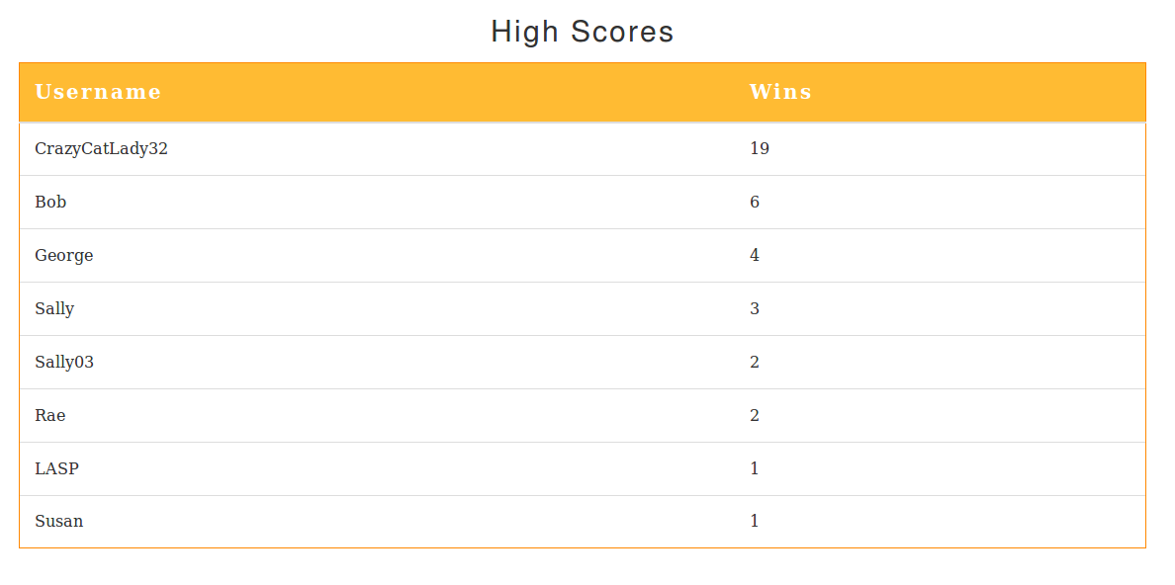
Figure 12. Table generation from dummy project

Slide 40
Directory Setup
ExampleSite/
Run.py
Dbconnect.py
exampledb.db
static/
styles/
base.css
templates/
base.html
home.html
Notes:
ExampleSite dir will be included with presentation materials.

Slide 41
SQL Injection
Malicious code injection in SQL statements through web inputs (such as registration pages) to destroy or steal data
Prevention includes input validation/sanitization and firewalls
SQL Injection Cheat Sheet:
https://www.netsparker.com/blog/web-security/sql-injection-cheat-sheet/
Example of defenses:
https://www.owasp.org/index.php/SQL_Injection_Prevention_Cheat_Sheet

Slide 42
Homework
Create a complete webpage with a sidebar and navigation bar. Include some sort of object that interfaces with the database-- such as a table that displays data, a form to insert data, or a login system that affects the values that are displayed on the page depending on who the current user is. HINT: for a login system, you should look at Flask’s sessions.
If you create a form, experiment with SQL injection. Try to destroy your database by inputting malicious commands, and then find a way to protect your database from SQL injection.

